Slide 1
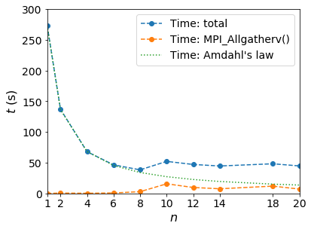
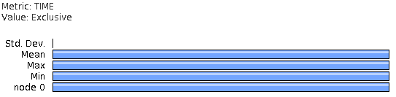
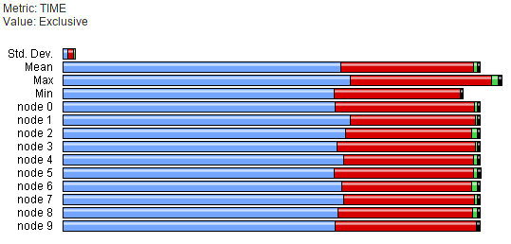
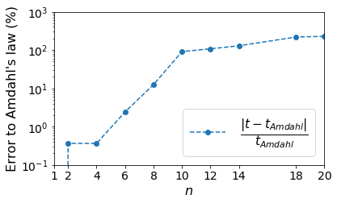
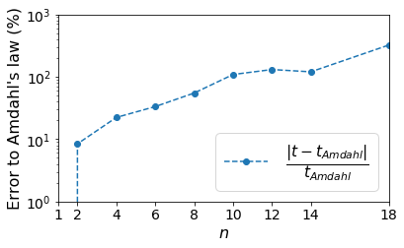
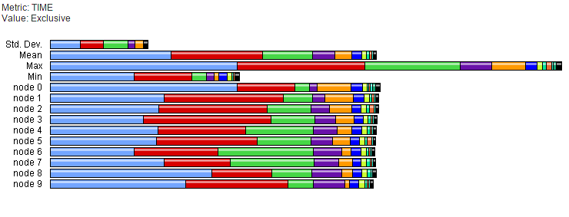
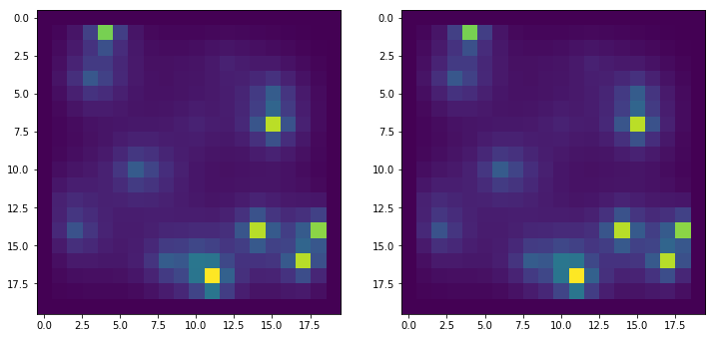
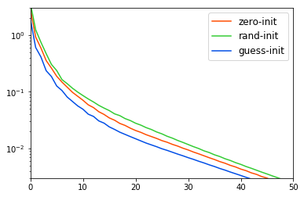
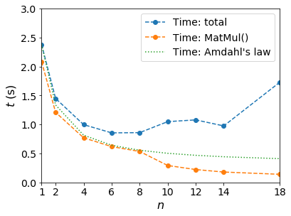
Parallelization of Poisson Equation Solver with Debye-Huckel’s Linear Term
Yueze Tan
Department of Materials Science and Engineering, Pennsylvania State University
yut75@psu.edu
Problem of Interest
Parallelization: MPI
Strong Scaling: Time v.s. Nprocs
The problem is related with solving the electrostatic equation (Poisson equation) in a system with free moving charges and shielding effects, typical examples of which would be plasma or electrolytes. From Boltzmann's distribution we can obtain the equation describing the shielded, or compensated field:
in which Φ is the electric potential, ρ is the charge density which is contributed by other effects than shielding, like charge density induced by inhomogeneous distribution of polarization in a dielectric matter, and ε is permittivity of the system. λ_{D} is known as Debye length, which is a term coming from Debye-Huckel's linearization of the electric shielding effect.
The problem could be constructed as a linear
equation ultimately, with the form of Ax = b,
and
Note that A is diagonally dominant, which makes it possible to use both direct and iterative methods to solve this linear problem.
The parallelization method used in this project is MPI. Since the system matrix A could become considerably large for those product-size problems, it is a better practice to use a distributed memory method to carry out the parallelization.
For the serial code, the iterative matrix-vector multiplication itself takes ~100% percent of execution time:
Therefore the portion could be accelerated by parallelization is large for the solver. Profile of parallel version of code indicates the solving steps are still taking most of the time, and for large number of processes, the communication overhead is also obvious:
Blue: Timing for MatMul(). Red: Timing for MPI_Allgatherv().
For the effect of acceleration, please refer to
the “strong scaling” part. The speed up is
considerably close to the theoretical limit, i.e.,
computational time decreases as O(1/N).
For strong scaling study, we keep the problem size fixed with varying number of processes.
For number of processes not exceeding the
number of cores on a single node, the scaling
follows Amdahl’s law in a considerably precise
way:
S(s) = t_{serial} / t_{parallel} = 1 / [(1 - p) + p / s] ≈ s = N,
with N as the minimum number of processes.
The speed of the code is limited ultimately by
the computational resources available to the
user. For test case shown, we have 8 cores on
single node, and N = 8 reaches maximum of
speed. Plot below shows the deviation from Amdahl’s law:
From the figure we can see the results are close to Amdahl’s law for small numbers of processes. Deviation from Amdahl’s law for MKL linked code is shown as below:
Serial: Direct and Iterative
Both direct and iterative solvers are used for serial version of code, and only iterative part has been parallelized.
For direct solver, PLU decomposition is used, so that for a given linear system Ax = b, with PA = LU, we can solve x using
x = U⁻¹L⁻¹Pb.
The iterative solver makes use of Jacobi iterative method. Since the system matrix A is diagonally dominant, this iterative method converges unconditionally, and is reliable for most usual inputs. To get the result, the vector to be solved is updated iteratively:
Where D, L, U are diagonal, lower half, upper half of A matrix, respectively. A comparison between solutions for electric potential from direct (left) and iterative (right) solver is attached as below:
From which we can see the results are considerably close to each other. Iterative errors during different steps decrease as the process goes on:
Horizontal: iterative steps. Vertical: max(x^{(k+1)}-x^{(k)})
Linking with External Library: MKL
The code could be further accelerated with math libraries. On Intel architectures, MKL is typically a good choice of math library.
Linking of MKL reduces the execution time for test case drastically, from ~270 s down to ~2.5 s. It could be seen from the profiling results that with the linking of MKL library, the matrix multiplication is not anymore the most time consuming part of code, even for small number of processes. The profiling result can be seen as below:
In the plot, blue bars are for MPI_Barrier() calls, and matrix multiplication is the red part, which is significantly shortened compared to the original case.
Combining MPI parallelization and MKL library gives a giant leap for performance of the iterative solver. Below is the timing results of test cases for MKL + MPI code with different numbers of processes. Compared to MPI timing in the right top panel we can see an obviously shortened time:
Acknowledgements
The bracket notation in calling of the matrix element and the stream output operator of matrix are inspired by the grammar from linear algebra template header library named Eigen: http://eigen.tuxfamily.org . The author appreciates using of these notations which
make debugging a more concise process.
The lecturers have provided with a compiled version of tau with support of MPI, which makes profiling a more fluent work. The author would also like to thank their work on making this tool available.
Code Publication
The source code of the contents mentioned in this poster could be retrieved at Github:
https://github.com/sunnyssk .
You could download the archive directly from the webpage.
References:
[1] Li, Y., Hu, S., Liu, Z., and Chen, L.-Q. Effect of electrical boundary conditions on ferroelectric domain structures in thin films. Appl. Phys. Lett. 81, 3 (2002).

